Slide 1
Overview of Banking Systems
Presented by : –
1. Sanket 6. Tanishq
2. Thejaswini 7. Sujan
3. Susan 8. Mis ab
4. Venkatesh 9. Simran
5. Ajaykrishna 10. Prathamesh
05-12-2023

Slide 2
History And Growth Of Banking Systems
The Indian Banking System Traces Back Its History to 1786. When The First Bank In India (The General Bank Of India) Was Established.
The Journey of Indian Banking System Can Be Divided Into Three Phases.
Phase I (Early Phase From 1786 to 1969 Of Indian Banks) .
19th century, BBM Presidency Banks, Imperial Bank Of India ,RBI 1935
Phase II (Nationalization of Indian Banks and Up to 1991 Prior To Indian Banking Sector Reforms)- SBI , agent of RBI ,RRB.
Phase lll (New Phase Indian Financial And Banking Sector Reform After 1991) – Liberalization of banking practices, new BOI with PNB 1993

Slide 3
What is Bank
A Bank is a Financial Institution licensed to collect deposits and give loans to the customer.
There are several types of banks including Retail, Wholesale, Commercial or Investment banks.
Conventional Banking are in the Business of lending & Borrowing money based on interest.
Islamic Banking is the one that involves profit-sharing, interest-free loans, and other financial services based on the principles of Islamic Sharia law.
What is Sharia principles in banking ?
Some of the Core Principles Include : Not charging interest to borrow money. No (Riba) interest on savings accounts. Restricted practices such as Gambling,Drugs, Tobacco or Alcohol.

Slide 4
Understanding Islamic Vs Conventional Banking
Islamic Banking | Conventional Banking
Based on the Principles of Islamic Sharia | Based on Man Made Principles
Absence of Interest Based Transactions | Only aims at Maximizes Profits
These bank pays much attention to developing projects and innovations as they are sharing profit/loss | Since here income are fixed little importance to projects
Relation to the clients is like partners and investors or Trader . | Relation to the clients is like Creditors and Debtors .
In case of default ,they doesn’t charge extra money | Additional is charge if defaults
Ex. Al Rajhi Bank | Ex. SBI

Slide 5
Meaning of Retail Banking
Retail Banking : Also Known As Consumer Banking /Personal Banking Provides Financial Services To Individual Consumers Rather Than Businesses.
The Three Important Functions Are Credit ,Deposit And Money Management
Retail Banking Services Are Provided To Individuals In The General Public.
Corporate Banking Services Are Only Provided To Small Or Large Companies And Corporate Bodies.

Slide 6
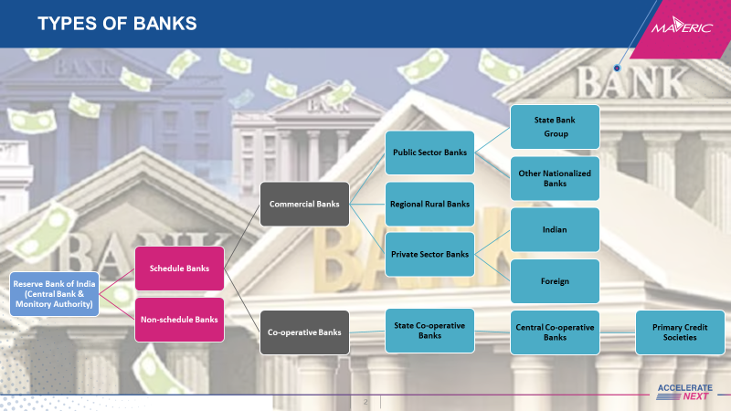
TYPES OF BANKS

Slide 7

Central Bank
The Central bank manages the currency of the country or group of countries and controls the money supply.
The Reserve Bank of India is owned by the government India and is the central Bank of India
Other Examples: Bank of England, Reserve Bank of Australia.

Slide 8
Scheduled Banks
Scheduled banks are those banks that are included in the second schedule of the Reserve Bank India Act 1934. Inclusion in the schedule means that these banks are regulated and supervised by the Reserve Bank of India (RBI).
They maintain a Cash Reserve Ratio (CRR) with RBI.
Cash Reserve Ratio (CRR) is the specified minimum portion of the total deposits of its customers which will be deposited with RBI.
Banks here are more reliable – regular inspection & supervision
Access to RBI facilities.
HDFC, Axis Bank, PNB, etc.

Slide 9
Non-Schedule Banks
Non-Scheduled banks are financial institutions that are not regulated by Reserve bank of India.
Cash Reserve Ratio (CRR) are kept by themselves.
They do not get to enjoy the formal regulatory recognition provided by the RBI.
Do not get facilities like interbank loans.
Many Non-Scheduled banks provide important financial services to rural and underserved populations
Baroda City Co-operative bank, Phagwara’s capital local area bank Ltd.

Slide 10
Based on operations
Co-operative Banks | Non-Cooperative Banks
Owned and operated by the members (Customers), usually to a particular community. | Not Owned and operated by the members (Customers), of the bank
Democratic | Hierarchical
Focus: Customer service | Focus: Profit
Narrow range of products and services | Wide range of products and services
Lower fees and more competitive Interest rates | Higher fees and competitive Interest rates
Baroda city Cooperative bank, Saraswat cooperative bank. | Citi Bank, HSBC, SBI

Slide 11
Based on Ownership
Public Sector Banks | Private Sector Banks
In Public sector banks, Government own major part of the bank’s equity. | Private individuals or private customers own major part of the bank’s equity.
Controlled by the government | Controlled by Companies or an individual
Interest rates for loans are less | Interest rates for loans are high
Play major role in economic development, providing loans to small businesses, farmers, investing in infrastructures | Focus on profitability, meaning they provide products and services that are designed to generate returns for their shareholder
SBI, PNB, Union Bank of India | ICICI, HDFC, Axis Bank, Karnataka Bank

Slide 12

Regional Banks
Operating at regional levels in different states of India.
Smaller in scale.
Focused on serving rural and local communities.
Strong presence and understanding of local market.
Eg : Federal bank, Kaveri Grameen Bank.

Slide 13
Private Banks
Indian Banks | Foreign Banks
ICICI Bank | JP Morgan Chase
HDFC Bank | Wells Fargo
Axis Bank | City Bank

Slide 14
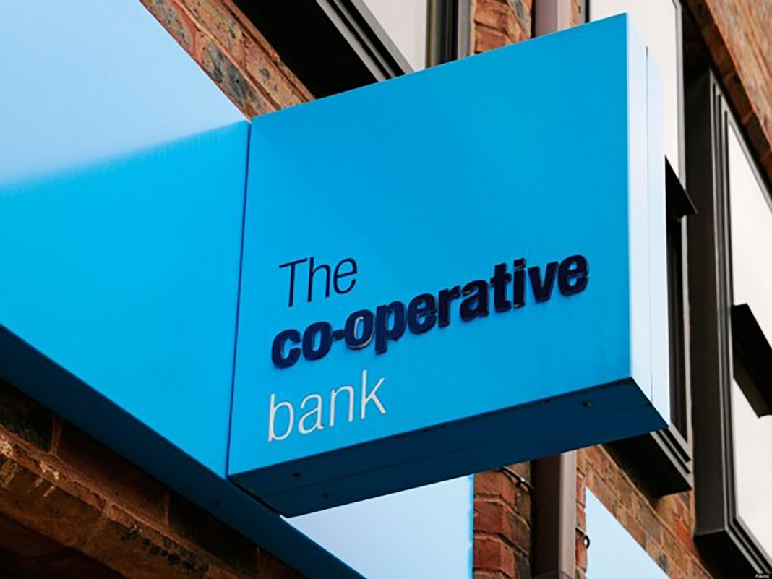
Central and State Co-operative Bank
State Co-operative banks: Karnataka Co-operative banks, Bihar Co-operative banks, AP Co-operative bank
Central Co-operative banks: Serves as the apex bank for the cooperative credit institutions in the state Eg: Bangalore central Co-operative bank

Slide 15

Credit Union
A credit union is a type of financial cooperative that is owned and operated by its members.
Members of a credit union share a common bond, such as living in the same community, working for the same employer, or belonging to the same organization.
Eg: Pentagon Federal credit union, Navy federal credit union etc.

Slide 16
Banking Architecture
Legacy Systems
A legacy system is outdated computing software and/or hardware that is still in use.
Legacy core banking systems are often decades old, mainframe-based platforms that support a bank's back-end operations across core functions such as account opening, account set up, transaction processing, deposits processing, loan processing and more.
COBOL is a legacy language that has been used for many years as the foundation of banking systems.
COBOL is the standard language for mainframe application development.
Handling large-scale batch and transaction processing jobs.

Slide 17
CORE Banking – Centralized Online Real-time Environment
Customer can experience the bank as a single entity, regardless of their location.
Core Banking is the back-end system that connects multiple branches of the same bank together to deliver operations like loan management, withdrawals, deposits, payments all in real-time.
Services include new account creation, CRM, interest calculations, deposits, withdrawals, loan issuing etc.,
When customer withdraws money from ATM, application sends request to the centralized data center, which can process the request and authenticates the operation.

Slide 18
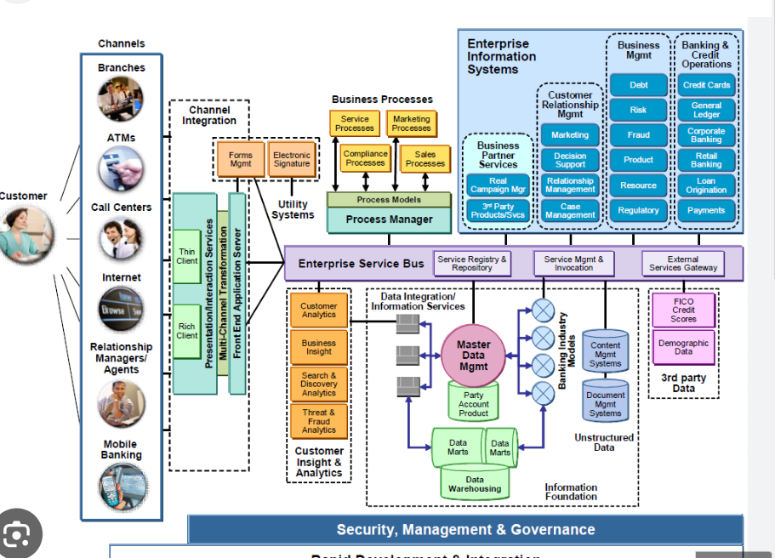
Banking Architecture

Slide 19
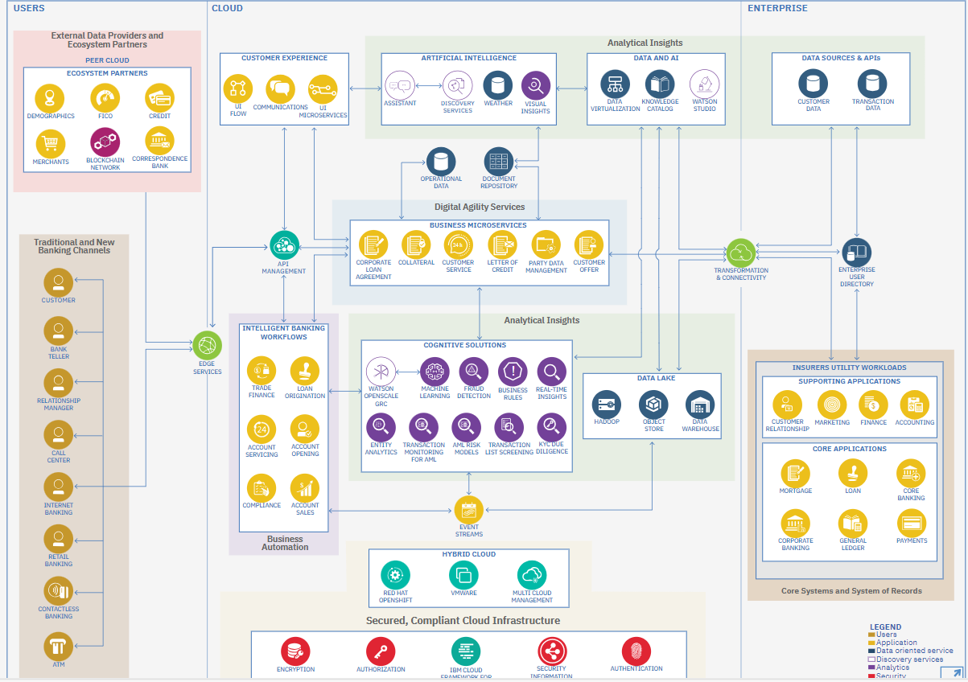
Modern Day Banking Application Architecture

Slide 20
Simplified architecture
Digital Banking architectures:
A typical layered mobile banking system architecture consists of three layers:
Presentation layer (front end)
Middleware layer
Backend layer
Presentation Layer: channels
Web, mobile browser, mobile app, wearables, IoT, ATM, chatbots
The presentation layer handles the browser and user interface communication logic.

Slide 21
Simplified architecture
Middleware Layer: it has 3 layers
1)security: primary importance
Authentication, firewall, mobile security, web security
2) Integration: used to connect presentation and backend layers
Messaging, processing, quality of service, management
3) Orchestration: used to perform required actions hence called as central nervous system of digital banking
Processing, rules

Slide 22
Simplified architecture
Backend layer:
Internal API’s, External API’s, digital banking platforms, internal API’s
Data and Analytics:
Data warehousing, cloud data warehousing, analytics
Banking Core system:
Customer, transactions, payments, accounting.

Slide 23
Banking Products
1
Savings Accounts
2
Current Accounts
A safe and secure way to store and grow your money while earning interest on balance.
Eligible for all resident Indian customers aged 18 and above.
Can be opened through branch visits or online banking.
Work best for entrepreneurs who need to access their accounts frequently.
Requires higher minimum balance than savings accounts.
No interest and charges may incur
fees
3
Terms Deposits
4
Loans
Fulfill your financial needs with various loan options, such as personal loans, mortgages, and auto loans.
Fixed-term investments that offer higher interest rates for those willing to lock their money away for a set period of time.

Slide 24
Features of Savings Account
The balance in a savings account earns interest.
Savings account interest rates on savings account can range from 3.5% to 7% p.a.
restriction on the number of transactions in a day
Easy access to internet banking and mobile banking.
Most banks also provide savings account holders with various insurance covers including personal accidents and death.

Slide 25
Types of Savings Account
1
Regular Savings Account
2
Salary Based Savings Account
Opened with basic terms and conditions.
Typically used for irregular deposits and safekeeping of funds.
No minimum balance requirement for most salary accounts.
If no salary is credited for 3 consecutive months, it may convert to a regular savings account
3
Senior Citizens Saving Account
4
Minor's Saving Account
Offers higher interest rates.
Linked to other senior citizen savings schemes.
Consolidates retirement account and pension funds into one account
No minimum balance requirement.
Operated under legal guardian supervision.
Converts to a regular savings account when the child turns 18.

Slide 26
Features of Current Account
Requires a higher minimum balance and offers overdraft facility.
It is designed to facilitate frequent transactions – transfer funds, receive cheques, cash, etc.
No restriction on the number of transactions in a day.
Non-maintenance of the minimum balance can attract penalty charges.
Generally, does not earn interest and may incur fees for banking services.

Slide 27



NRO - Non-Resident Ordinary Account
Purpose
Eligibility & Documentation
Features & Restrictions
NRO accounts are designed for non-resident Indians to manage their income earned in India, including rental income, dividends, or pension payments.
Have certain limitations, such as restricted repatriation of funds and subject to taxation in India. However, they provide a convenient way to manage finances within the country.
All NRIs and people of Indian origin are eligible for NRO accounts. Basic documents such as passport, visa, and address proof are required for opening an account.

Slide 28
NRE - Non-Resident External Account
2
Eligibility & Documentation
3
Benefits & Limitations
1
Purpose
NRE accounts allow non-resident Indians to maintain their income earned abroad in Indian rupees, making it easier to manage their finances back home.
Indian citizens residing outside India, as well as people of Indian origin, can open NRE accounts by providing relevant identification and address proofs.
NRE accounts offer repatriation of funds, tax benefits, and the ability to hold multiple currencies. However, they cannot be used for local transactions in India.

Slide 29
Life Cycle of a Banking Account
Account Opening
1
This is the initial stage where a customer opens a new account with a bank.
Provides necessary documents, completes application forms, and agrees to the terms and conditions of the account.
Account Activation
2
After the account is opened, it needs to be activated. This may involve depositing an initial amount of money into the account
Account Usage and Maintenance
3
After account is activated, customer can do transactions and Account holders are expected to maintain their accounts in good standing by adhering to the bank's policies and regulations.
Account Upgrades or Changes
4
Explore the options available for customers to upgrade or downgrade their banking accounts based on changing financial needs and services.
Account Closures​
5
Understand the reasons and processes involved in closing a banking account, including account termination and associated considerations.​

Slide 30
Benefits of Understanding the Life Cycle of Banking Accounts
1
Informed Financial Decision-Making
2
Prevention of Fees and Penalties
3
Improved Customer Satisfaction and Retention
Choosing the right type of account, understanding associated fees, and managing their accounts to avoid unnecessary charges.
Awareness of account maintenance requirements, fees, and penalties helps customers avoid unnecessary charges.
communication about account features, changes, and policies fosters a positive relationship between the bank and its customers.

Slide 31
Term Deposit
A time deposit or term deposit is a deposit in a financial institution with a specific maturity date or a period to maturity

Slide 32
Types of Term Deposit
On the basis of purpose they serve, term deposit may be classified as follows:
Fixed deposit
Recurring deposit

Slide 33
Fixed deposit vs Recurring deposit
FIXED DEPOSIT
Used for depositing lump sum amount at one time​
Tenure ranges from 7 days to 10 years​
​
Interest is high than RD​
Interest gets credited on quarterly/monthly or on maturity​
​
Loan can be availed
RECURRING DEPOSIT
Used for depositing small amounts but on regular basis​
Tenure ranges from 6 months to 10 years​
Interest is low than FD​
Interest is paid on maturity along with capital amount​
​
Loan can be availed​

Slide 34
Account Status
Account Status refers to the current condition of an account, the types of
Account status are
Inactive account
Dormant account
Deceased account
Account Blocked / Frozen

Slide 35
FCNR - Foreign Currency Non-Resident Account
1
Purpose
FCNR accounts are term deposit accounts denominated in foreign currency, allowing non-resident Indians to hold their overseas income securely in Indian banks.
2
Eligibility & Documentation
NRIs and persons of Indian origin can open FCNR accounts by providing necessary KYC documents such as passports, visas, and address proofs.
3
Advantages & Limitations
Benefits of FCNR accounts include protection against foreign exchange risks, higher interest rates, and tax exemptions. However, premature withdrawals may attract penalties.

Slide 36
Know Your Customer(KYC)
Know Your Customer is a mandatory procedure in India that helps banks, every financial institutions verify customer’s address, identities before conducting transactions. It includes verifying the customer’s identity, address, occupation, financial status and other details.
It helps cut down unlawful practices like money laundering, fraud or financial illegal activities. It is required to open Bank accounts, Demat and trading accounts, start FD, invest in mutual funds and for applying loans.

Slide 37
ACCOUNT PROFILING
Process of creating detailed profiles of individual or business bank account holders.
Helps financial institutions better understand their customers, manage risks, and tailor their services to meet specific needs.
Essential for creating a personalized and secure banking experience, promoting regulatory compliance, and mitigation risks associated with financial transactions.
It’s crucial to balance the benefits of profiling with respect for customer privacy and data protection regulations.

Slide 38
ACCOUNT PROFILING
PSYCHOGRAPHIC
Psychological make-up of a customer include following factors :
Lifestyle
Goals
Pains
Habits
Values
Interests
DEMOGRAPHIC
Used to understand consumers
characteristics. Demographic includes
following traits :
Age
Sex
Job Title
Income
Education Level
Family Status

Slide 39
ACCOUNT PROFILING
GEOGRAPHIC
Geographical factors are relevant when location can affect how customers interact with a brand or receive their products. Below are the geographical
ways :
City
Area
Region
Country
BEHAVIORAL
Used to understand customers behaviour.
This include following factors :
Engagement
Readiness to buy
Purchasing History
Product Usage
Satisfaction
Loyalty or Account Age
Attention Required

Slide 40
TRANSACTION SERVICES
Pay order
- Once ordered cannot be cancelled
Cheque
- Acc pay & Non Acc pay
Demand Draft
- Issued by bank
Money transfer
- NEFT, IMPS, RTGS
Mobile banking
- App services for remote transactions
Standing Instructions
- Auto debit- diff online subscription platforms/account
Foreign Exchange
- Travel cheque, Forex cards, Travel credit cards

Slide 41

PAYMENT GATEWAY
What is a Payment Gateway?
A payment gateway is a platform that allows any online business to accept payment. It can offer payment options like cards (debit and credit), digital wallets, UPI and more.
Traditionally payment gateways in India were provided by banks in the early 90s. But, since the late 90s, private 3rd party corporations have entered the foray.
Today, most organizations integrate with these third-party payment processors to collect payments from their customers. Similarly, they can also help to disburse payments to vendors and employees.

Slide 42
1. COMPONENTS OF PAYMENT GATEWAY
In a card payment system, several components work together to facilitate transactions. These components include cardholders, merchants, acquiring banks, issuing banks, and payment networks.
Cardholder: The user who decides to pay for goods or services on your website. Individuals or businesses that hold payment cards like credit, debit, or prepaid cards. They use these cards to initiate transactions by making purchases.
Merchant: Businesses that accept card payments from customers. They have point-of-sale terminals or online payment gateways connected to acquirers.
Acquiring bank: The bank that handles the backend processing of transactions processes card payments for merchants.
Payment networks: such as Visa, Mastercard, American Express, or Discover, connect issuers and acquirers. They develop network rules, facilitate funding exchanges between parties, and handle aspects like fraud prevention.
Issuing bank: The bank issues payment cards to users and businesses. They manage cardholder accounts, set credit limits, collect fees and interest, and process authorization and settlement.

Slide 43
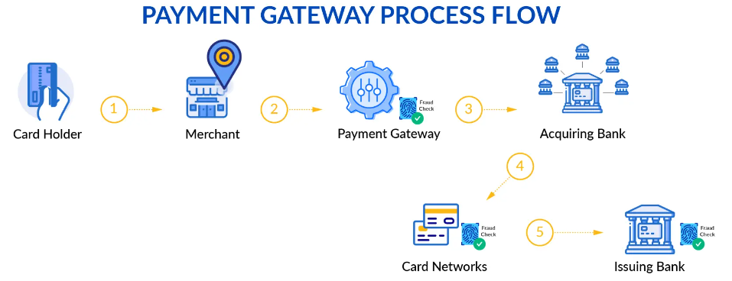
2. WORKFLOW OF PAYMENT GATEWAY

Slide 44
PAYMENT GATEWAY WORK FLOW STEPS :
Step 1: When checking out, the users (cardholders) initiate purchases by providing their card details to merchants.
Step 2: The card information and transaction details are sent from the merchant to the payment gateway securely (how the merchant transfers card data may differ depending on which payment gateway type it chooses).
Step 3: The payment gateway encrypts card information and fraud checks and sends card data to the acquiring bank.
Step 4: The acquiring bank then forwards card data to card networks for fraud checks and routes to the issuing bank according to card information.
Step 5: The issuing bank authorizes and settles the payment. Finally, it returns the transaction status back to the merchant for fulfillment and notifies the user whether his order is successful.
Each component plays a crucial role in facilitating the transaction, ensuring the smooth flow of information and funds between cardholders, merchants, acquirers, issuing banks, and payment networks.

Slide 45

PAYMENT NETWORKS
What is a Payment Network?
A payment network is, in the most simple terms, a system that allows for money to move from one party to another. More specifically, payment networks are an association of financial institutions facilitating payments between customers and merchants. A payment network can refer to any EFT network, ACH payment system, credit card association, or any other organization that facilitates transactions between two or more parties.

Slide 46
HOW DO PAYMENT NETWORK WORKS
payment networks work varies depending on the type of payment network.
Credit card networks: Credit card networks involve customers (ie, the cardholders), merchants, the issuing bank, the acquiring bank, and the credit card association. When customers enter their card numbers into a payment portal on a website, this signals the card issuer (the issuing bank) to loan them the money for the purchase. Next, the card network gathers information about the buyers and their intended purchase and sends it to the acquiring bank. This bank will then request payment authorization from the card-issuing bank via the card network before the payment can go through.
EFT networks: EFT stands for electronic fund transfer and refers to any kind of payment supported by EFT technology that makes it possible to move money electronically among banks, individuals, businesses, and other parties. That includes various digital funds transfers, including ACH payments, eChecks, peer-to-peer payments, direct deposits, ATM transactions, phone payments, in-app purchases, mobile payments, and credit and debit card payments.
ACH payments: ACH payments allow the electronic transfer of funds directly between two bank accounts. ACH stands for Automated Clearing House, the official electronic network that initiates payments from one bank account to another.

Slide 47
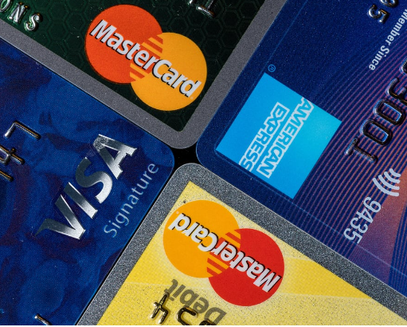
CREDIT CARD NETWORKS
Big four largest credit card networks are:
Visa
MasterCard
American Express
Discover

Slide 48

HOW THE PAYMENT NETWORK EARNS
Interchange Fees:
Interchange fees are one of the primary sources of revenue for payment networks. These fees are charged by the issuing bank to the acquiring bank for each transaction.
Assessment Fees:
Payment networks charge assessment fees to both the issuing and acquiring banks for the use of their network. These fees are typically based on a percentage of the transaction volume.
Transaction Fees:
Payment networks may charge fees for the authorization and processing of transactions. These fees contribute to the overall revenue of the network.
Cross-Border Fees:
For transactions involving different countries, payment networks may charge additional fees known as cross-border fees. These fees account for the added complexity and risk associated with international transactions.

Slide 49

Licensing and Branding Fees:
Merchants and financial institutions pay licensing and branding fees to use the payment network's brand and technology. This includes the right to issue cards and display the network's logo on payment cards.
Data and Analytics Services:
Payment networks leverage the vast amount of transaction data they process to offer data and analytics services to banks, merchants, and other stakeholders. These services may include insights into consumer behavior, fraud detection, and market trends.
Innovation and Technology Services:
Payment networks invest in research and development to enhance their technologies and introduce new payment solutions. They may charge fees for access to these innovations and technologies.

Slide 50

Partnerships and Alliances:
Payment networks often form partnerships with other financial institutions, technology companies, and service providers. These partnerships may involve revenue-sharing arrangements and joint ventures.
Card Issuance Fees:
Payment networks may receive fees for each card issued with their branding. This fee is paid by the issuing bank.
Security and Compliance Services:
Payment networks provide security and compliance services to ensure that transactions are secure and comply with industry standards, such as the Payment Card Industry Data Security Standard (PCI DSS). They may charge fees for these services.

Slide 51

Wealth Management
By - Simran Soni & Prathamesh Anilrao Videkar

Slide 52
Introduction to Wealth Management
What is Wealth?
Wealth is an abundance of valuable resources and assets.
It often goes beyond the mere possession of money and includes various forms of valuable possessions, such as real estate, investments, stocks, bonds, valuable goods, and resources.
What is Wealth Management?
Wealth management is a holistic service that focuses on helping mid- to high-net-worth clients grow their wealth, manage their liability exposure and devise strategies to pass their wealth on to their designated heirs.
The reason to use a wealth management firm is to seek strategies to help maintain and grow your total wealth.
Wealth Managers use a collaborative approach to learn more about the unique circumstances of their customers and then create a personalized plan using a range of financial products and services.
These advisors are high-level professionals and experts.
Wealth management is different from investment advice. The former is a more holistic approach in which a single manager coordinates all the services needed to manage their money and plan for the client's needs, including the current and future needs of the client's family.

Slide 53
How does Wealth Management Works?
Wealth management is a form of financial advisory provided to companies and individuals for proper management of financial matters.
Wealth management is tailor-made and client-specific. So, the products and investment types are suggested based on client’s preferences.
Risk appetite, timeline, liabilities, assets, etc., are kept in mind before devising a plan of action.
Steps Involved:
Assessment & Goal Setting: Understand client goals, risk tolerance, and financial situation.
Financial Planning: Develop a comprehensive financial strategy covering investments, taxes, retirement, and estate planning.
Implementation & Execution: Implement the plan by investing in diverse assets aligned with the strategy.
Ongoing Monitoring and Rebalancing: Regularly review and rebalance the portfolio to match changing goals, market conditions, and risk tolerance.
Relationship Management: Provide ongoing advice, support, and education while collaborating with other professionals for a holistic approach.
Education and Communication: Wealth managers aim to educate clients about financial matters, investment strategies, and market trends to ensure clients understand their financial position and the rationale behind recommended actions.

Slide 54




Services offered by Wealth Management Firms
Investment Management and Advice
Managing investments across different asset classes (stocks, bonds, etc.) according to the client's financial goals and risk tolerance.
Risk Management
Mitigates risks via diversification and insurance, aiming to safeguard against inflation and healthcare uncertainties.
Estate Planning
Assisting in estate planning, ensuring assets follow client’s wishes post-death through wills, trusts, and tax-minimization strategies.
Comprehensive Financial Planning It includes budgeting, savings, investments, insurance, and retirement strategies for individuals' financial well-being.
Tax planning and accounting services
Optimize taxes and investments through strategic planning, often working with accountants or providing in-house tax services.
Legal Services
Offering legal services for estate planning, trusts, and financial documentation, either in collaboration with legal professionals or in-house.
Philanthropic planning
Advising on charitable giving, setting up trusts or foundations, and maximizing philanthropic impact while considering tax implications..
Retirement planning
Wealth firms aid retirement planning through personalized strategies, savings optimization, and investment management.

Slide 55
Wealth Management - Products
Mutual Funds
Schemes according to Maturity Period:
Open-ended Fund/Scheme
Close-ended Fund/Scheme
Schemes According to investment Objective:
Equity Oriented MFs/Scheme
Debt Oriented MFs/Scheme
Balanced Fund
Sector Specific Schemes
Tax Saving Schemes

Slide 56
Wealth Management
Payment Options for Investment in MFs:
Lump Sum
single payment of money
SIP : Systematic Investment Plan
fixed sum of money at regular intervals
allow you to invest weekly, quarterly, or monthly
you can give your bank standing instructions to debit the amount every month

Slide 57
Wealth Management - Products
Insurances :
Life Insurance
Whole Life can be used as an income tool as well as an insurance instrument
includes a death benefit and also a cash value component
Term insurance - provides coverage for a certain period of time
Health Insurance
covers medical and surgical expenses of an insured individual.
Asset Insurance
Covers damage associated with fire, theft and accidental damage

Slide 58
Wealth Management - Benefits
Holistic Financial Planning
Diversification and Risk Management
Tax Efficiency
Regular Monitoring and Adjustments

Slide 59
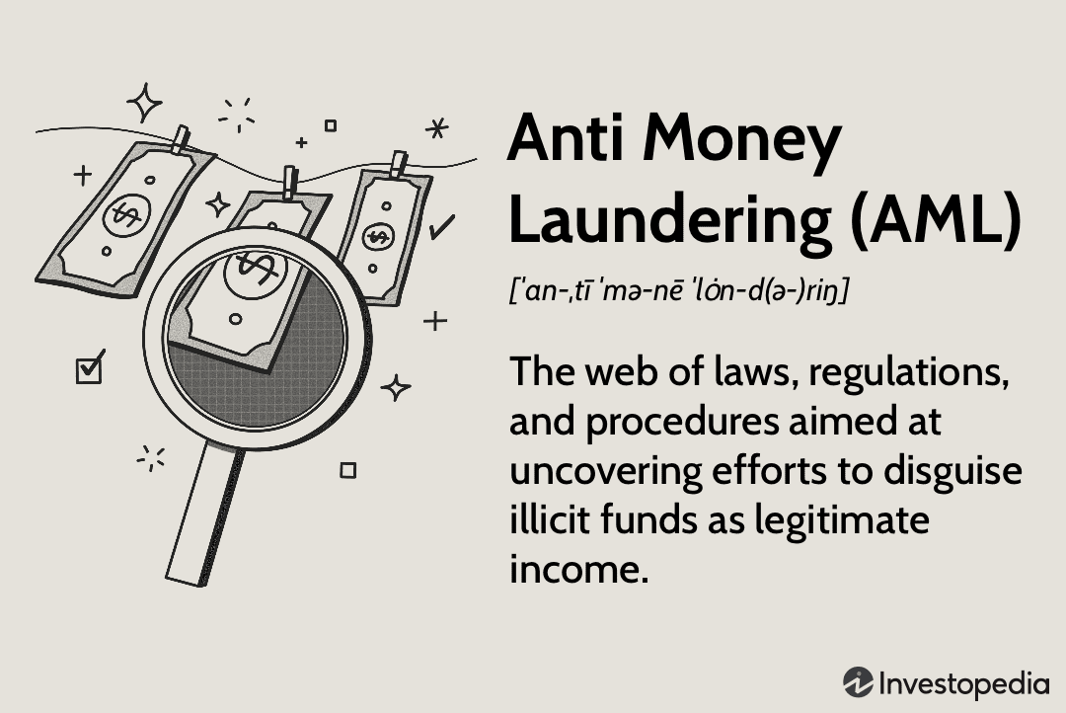
MONEY LAUNDERING
Money laundering is the process of creating the appearance that large amounts of money obtained from serious crimes,such as drug trafficking or terrorist activity,originated from a legitimate sources.
Layers in money laundering
Placement(inclusion of money in banks,financial entities)
Layering(doing complex transaction)
Integration(buying legal things,investing in CM,s assests)

Slide 60

ANTI MONEY LAUNDERING
AML
Anti money laundering refers to set of procedures, laws or regulations designed to stop the practice of generating income through illegal actions.

Slide 61
REPORTING TYPES
Cash Transaction Reports(CTRs)
Counterfeit Currency Reports(CCRs)
Suspicious Transactions Reports(STRs)
Non Profit Organisations Transactions Report (NPOs)

Slide 62
CTR
All cashe withdrawals and deposits for 10 lacs and above including individual cash transactionof less than rs 10 lacs but aggregating to 10 lacs in acalender month are to be reported by wat of cash transaction Report(CTR) to financialintelligenceUmit –india(FIU-IND) on prescribed format.
CCR
All instances of detection of counterfeit currency reported to RBI/police authorities are required to be reported to FIU-IND
CCRs are also required to be submitted to FIU-IND in respect of forgery of valuable security and documents,in plain text form,through the principal officer.

Slide 63
STR
All suspicious transactions whether or not made
Not later than seven working days on being satisfied that the transaction is suspicious
NTR
All transactions involving receipts by Non Profit Organizations of value more than Rs Ten lakhs or, its equivalent in foreign currency

Slide 64
Thank You

